Slide 1


Challenges and Strategies for Sentiment Analysis of Irony and Humor in Social Media Based on Machine Learning
Vergil/Zijun Li

Slide 2
Introduction
Irony and humor: complex and context-dependent expressions, making them difficult to analyze
01
Overview of machine learning techniques for sentiment analysis, ranging from traditional algorithms to deep learning approaches
02
Actual case analysis: HEMOS: A Novel Deep Learning-Based Fine-Grained Humor Detection Method for Sentiment Analysis of Social Media
03

Slide 3
Basic Concepts -Irony
Concepts of Irony
Often used to create humor, emphasize a point, or express subtle criticism
Common types: Verbal irony and Situational irony
Verbal irony: Conveys a meaning opposite or distinct from its literal meaning
Situational irony: Occurs when the opposite of what is expected transpires, typically used to create a dramatic effect or convey a moral lesson

Slide 4
Basic Concepts -Humor
Concepts of Humor
A multifaceted and subjective concept, often defined as a form of communication that elicits laughter and entertainment
Types: Ranging from slapstick and physical comedy to wit
We focus on verbal humor, which can be further classified into the following categories:
Self-irony: Often used to defuse tense situations or alleviate embarrassment
Exaggeration/Hyperbole: Utilizes extreme exaggeration to emphasize a point or add humor
Phonetics Assisted: Generates humor by manipulating phonetic and pronunciation features
Semantic Opposites: Uses words with opposite meanings to create a humorous effect
Secondary Meaning: A word or phrase with multiple meanings, used to create a humorous effect

Slide 5
Machine Learning Algorithms
Support Vector Machines (SVM): SVM seeks a hyperplane during training that maximizes the boundary between two distinct categories
Decision Trees & Random Forests: tree-based models that selecting each node based on a specific characteristic
Naive Bayes Classifier: a probabilistic classifier that uses Bayes' theorem to make predictions, often used for text classification

Slide 6
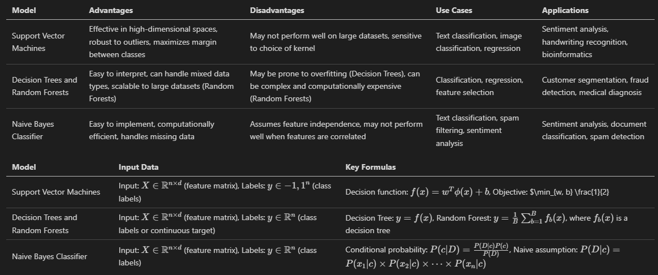
Machine Learning Algorithms

Slide 7
Deep Learning Algorithms
Convolutional Neural Networks (CNNs): a type of neural network that works well for image recognition and can also be used for text classification tasks
Recurrent Neural Networks (RNNs): Using the output from a previous time step as input to the current time step.
Transformers: acquiring a comprehensive feature representation of the input sequence by executing self-attention weighted aggregation on the features of all positions within the input sequence

Slide 8
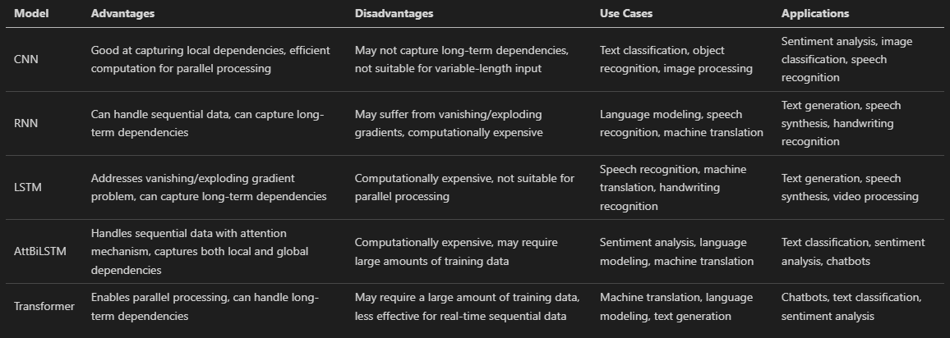
Deep Learning Algorithms

Slide 9
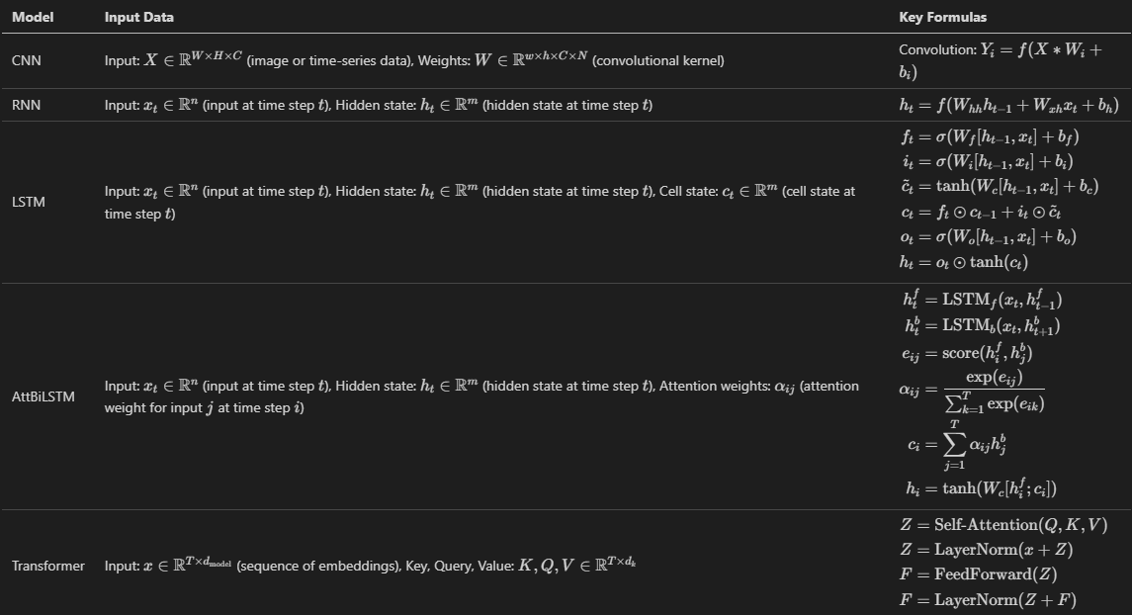
Deep Learning Algorithms

Slide 10
Actual Case Analysis - HEMOS System for Sentiment Analysis in Chinese Social Media
Study conducted by Da Li, Rafal Rzepka, Michal Ptaszynski, and Kenji Araki
Focus: Detecting humor in Weibo posts using lexicons and an AttBiLSTM recurrent neural network
HEMOS system: combined emoticons, slang, and text for a more nuanced understanding of content and improved sentiment analysis accuracy

Slide 11
Actual Case Analysis - Data Collection and Preprocessing
Collected 7.6 million Weibo posts, filtering out images and videos
Trained word embeddings using the word2vec model
Incorporated Chinese Internet slang and emoji lexicons into the Jieba text segmentation package

Slide 12
Actual Case Analysis - Model Training and Annotation
Collected 4000 Weibo posts containing ambiguous emojis
Annotated by three Chinese native speakers with four category labels: positive, negative, optimistic humorous, and pessimistic humorous
AttBiLSTM model trained with 10 epochs, dropout rate of 0.25, batch size of 64, and 10-fold cross-validation

Slide 13
Actual Case Analysis - Model Testing and Results
Tested on 180 Weibo entries with eight specific emojis
Compared results with and without considering Internet slang and emoji lexicons
Two-category sentiment classification: positive and negative
Four-category sentiment classification: positive, negative, optimistic humorous, and pessimistic humorous

Slide 14
Actual Case Analysis - Key Findings
Improved performance in humor detection and sentiment analysis when considering Internet slang and emoji lexicons
Enhanced accuracy in identifying humorous entries, which are difficult to polarize
Including "optimistic humorous" and "pessimistic humorous" categories improved the prediction of bi-polarity sentiment

Slide 15
Challenges of Irony and Humor Sentiment Analysis
Context-dependency
Diversity of forms
Complex language features
Cross-cultural differences

Slide 16
Future Directions and Outlook
Cross-lingual/cultural analysis
Multimodal information fusion
Automatic pattern discovery
Adversarial training
Model explainability/interpretability

Slide 17
Conclusion
- Concepts of Irony and Humor
- Classic Machine learning algorithm of the Sentiment analysis
- Actual Case analysis
- Challenges of Irony and Humor Sentiment Analysis
- Future Directions and Outlook

Slide 18
Thank you for watching

